Slide 1


APPARENT MOTION
Project by Patricia-Ioana Cucu & Sarah-Alexia Bratu
Students of Faculty of Aerospace Engineering-UNSTPB

Slide 2
Contents
Description of the project
What is Apparent Motion?
Equipment
Patterns
Testing & outcome
Conclusions

Slide 3
Description of the project
Exploring the Perceptual Dynamics of Apparent Motion in Response to Vibrating Motors
The project explores the perception of apparent motion through the use of vibration patterns.
The study focuses on understanding how participants perceive motion orientations, such as vertical or horizontal analyzing the duration of the stimuli, the time between the stimuli, the frequency and amplitude of sine waves.
Individual participants are identified by unique IDs and their responses are stored in a text file and analyzed to unveil patterns in the perceptual dynamics of apparent motion.

Slide 4


WHAT IS APPARENT MOTION?
In psychology, apparent motion refers to a visual illusion where a sequence of discrete images or stimuli is perceived as continuous motion. This phenomenon is studied to understand how the human brain processes visual information and constructs the perception of motion.
Creating effective vibrating signals (for blind individuals) involves consideration of apparent motion and how the brain processes tactile information. While vibrating signals can be a useful means of conveying information, there are challenges related to the perception of motion and the potential for confusion.

Slide 5
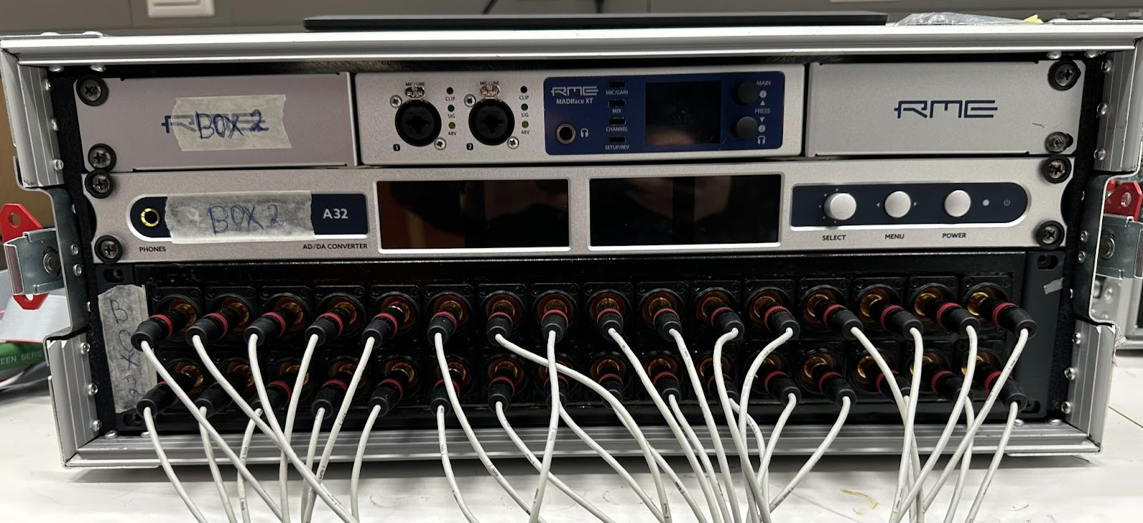

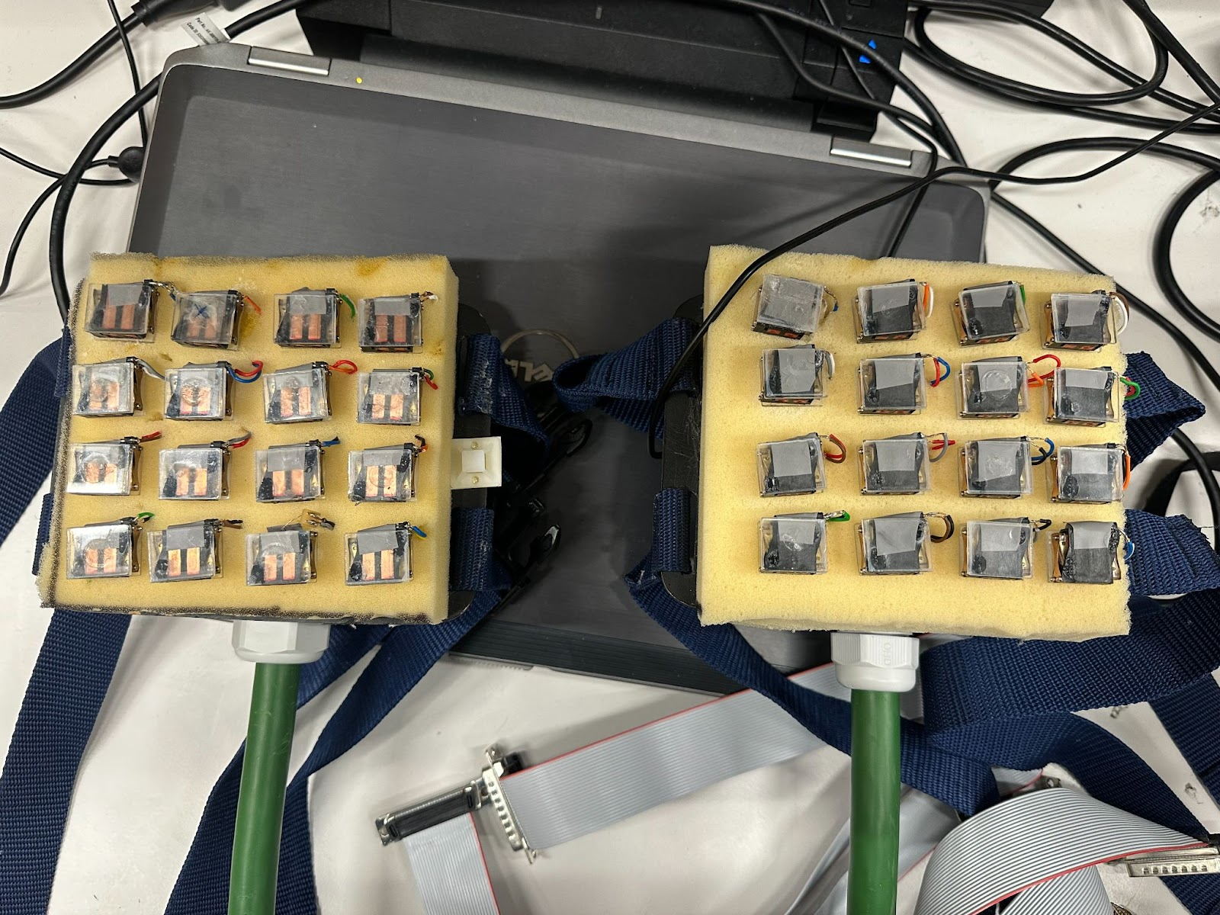
EQUIPMENT
"MADIface xt RME Audio" device
Tactile Pad
Windows computer

Slide 6

PREDeFINED PATTERNS

Slide 7
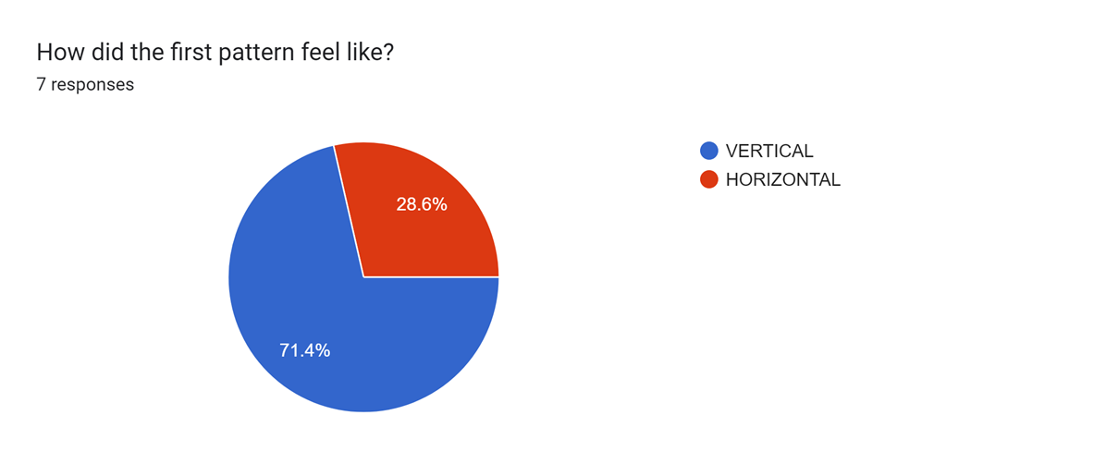
TESTING & OUTCOME
EXPERIMENT INFORMATION:
We conducted an experiment involving seven participants aged between 19 and 25.
Each participant was exposed to three distinct patterns of vibration presented in a randomized sequence.
Subsequently, participants were requested to say their perception of motion after each pattern, indicating whether they perceived it as vertical or horizontal.
The diverse interpretations of apparent motion among individuals are discernible within the depicted images:

Slide 8
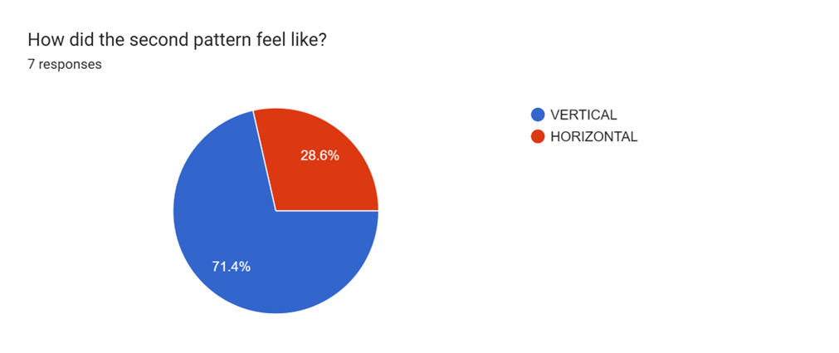
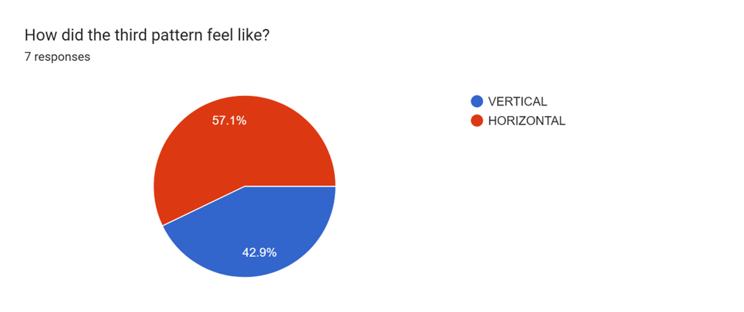

Slide 9

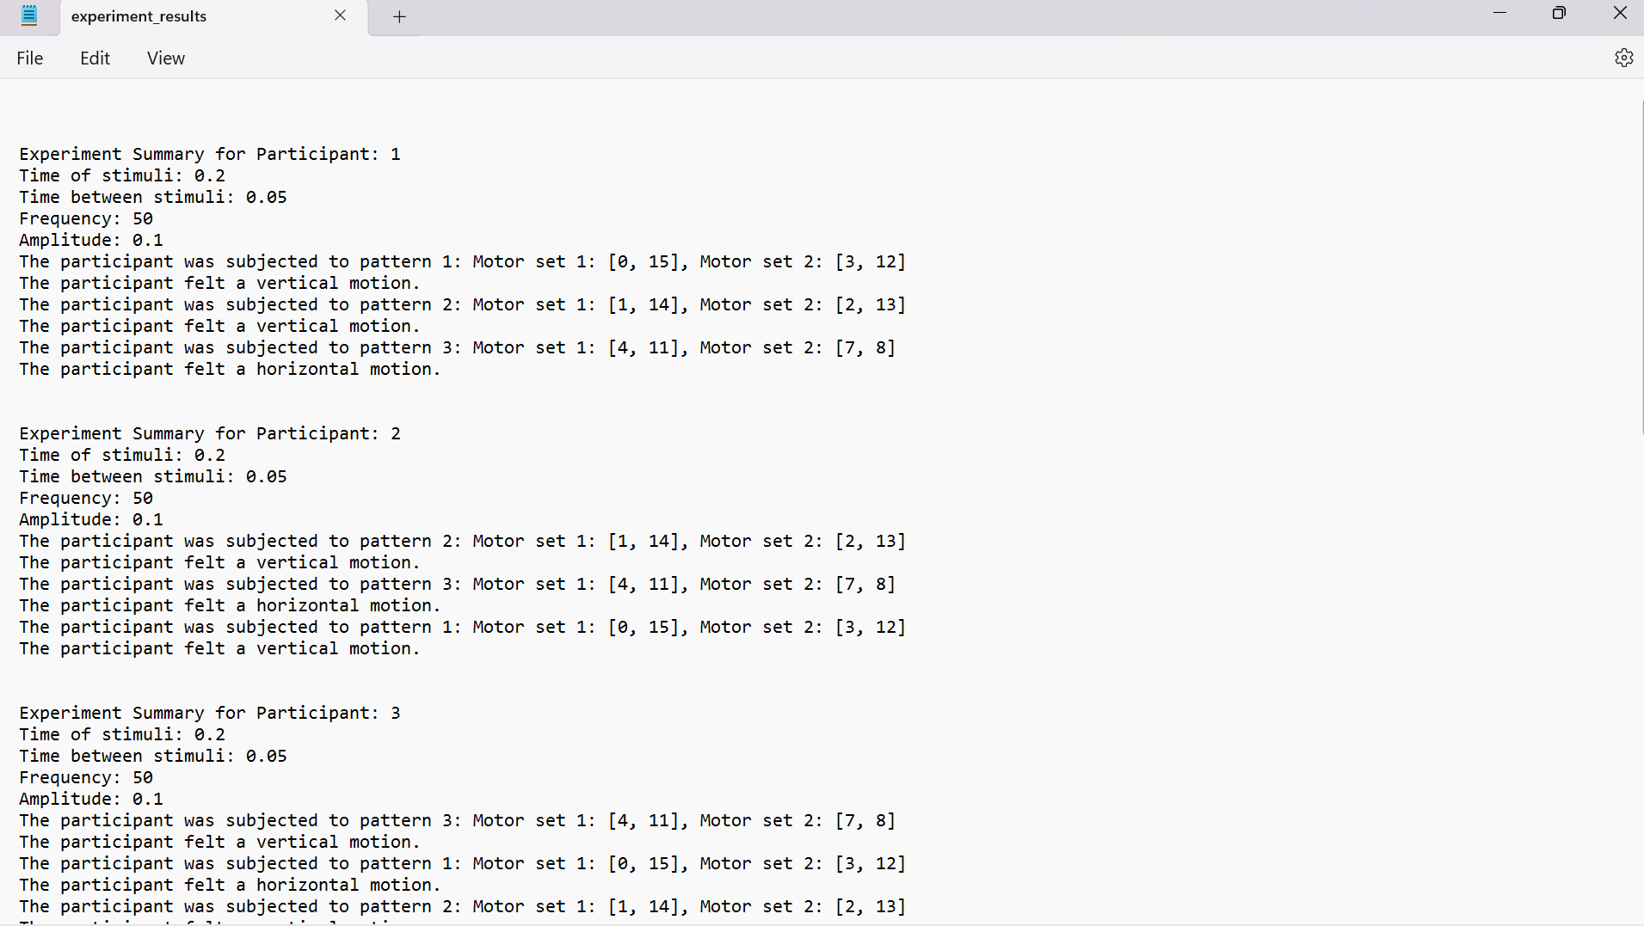

Slide 10
CONCLUSIONS
The startup test successfully verifies the functionality of the vibration motors by playing predefined patterns through them. The randomized selection of patterns ensures variability and accuracy in testing, contributing to the reliability of subsequent participant trials.
The participant responses to the apparent motion stimuli (vertical or horizontal) demonstrate variability across trials, which could be influenced by factors such as individual differences in perception, sensitivity to vibrations, or subjective interpretation of motion orientation.
The project effectively collects participant responses and experimental data, storing them in a structured format for further analysis. Analyzing the collected data could reveal patterns or trends in participant responses.

Slide 11
Thank you!
Project done by
Patricia Cucu & Sarah Bratu
patriciacucu@outlook.com
bratusarah@gmail.com
Students of the Aerospace Engineering Faculty - UNSTPB

